Slide 1
Types of attention

Slide 2
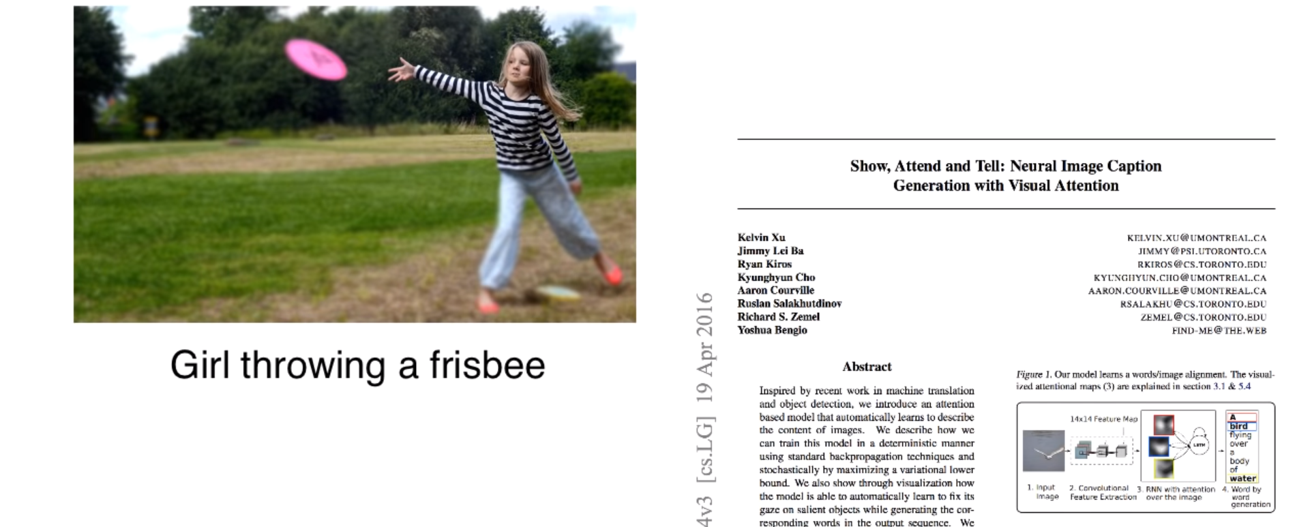
Attention

Slide 3
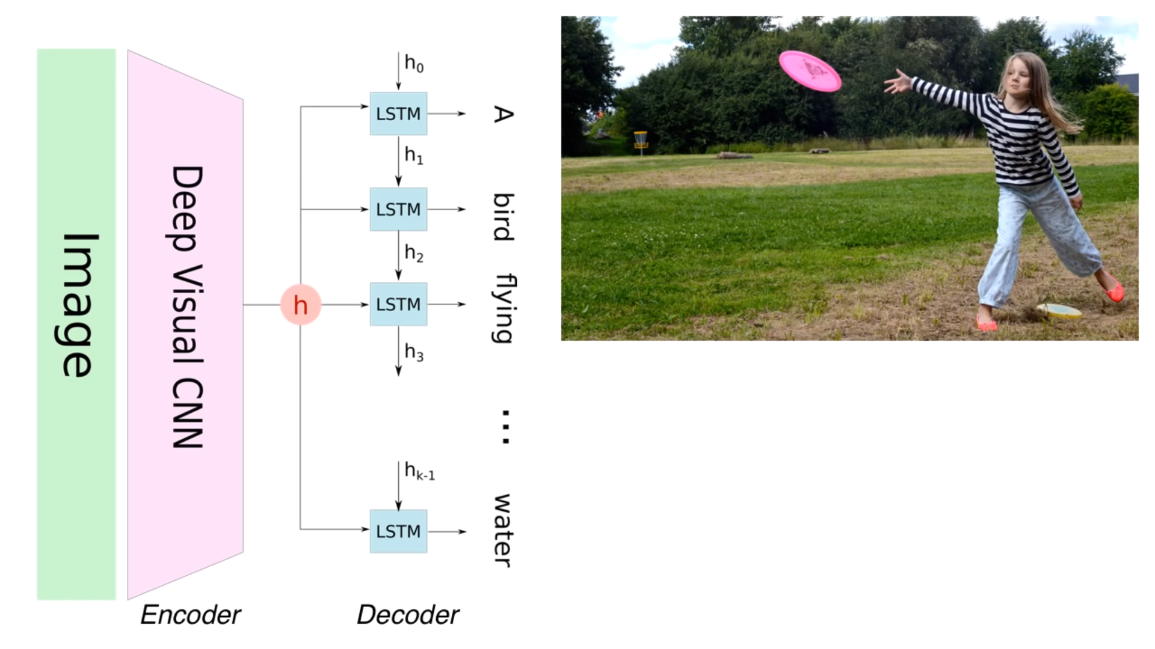

Slide 4
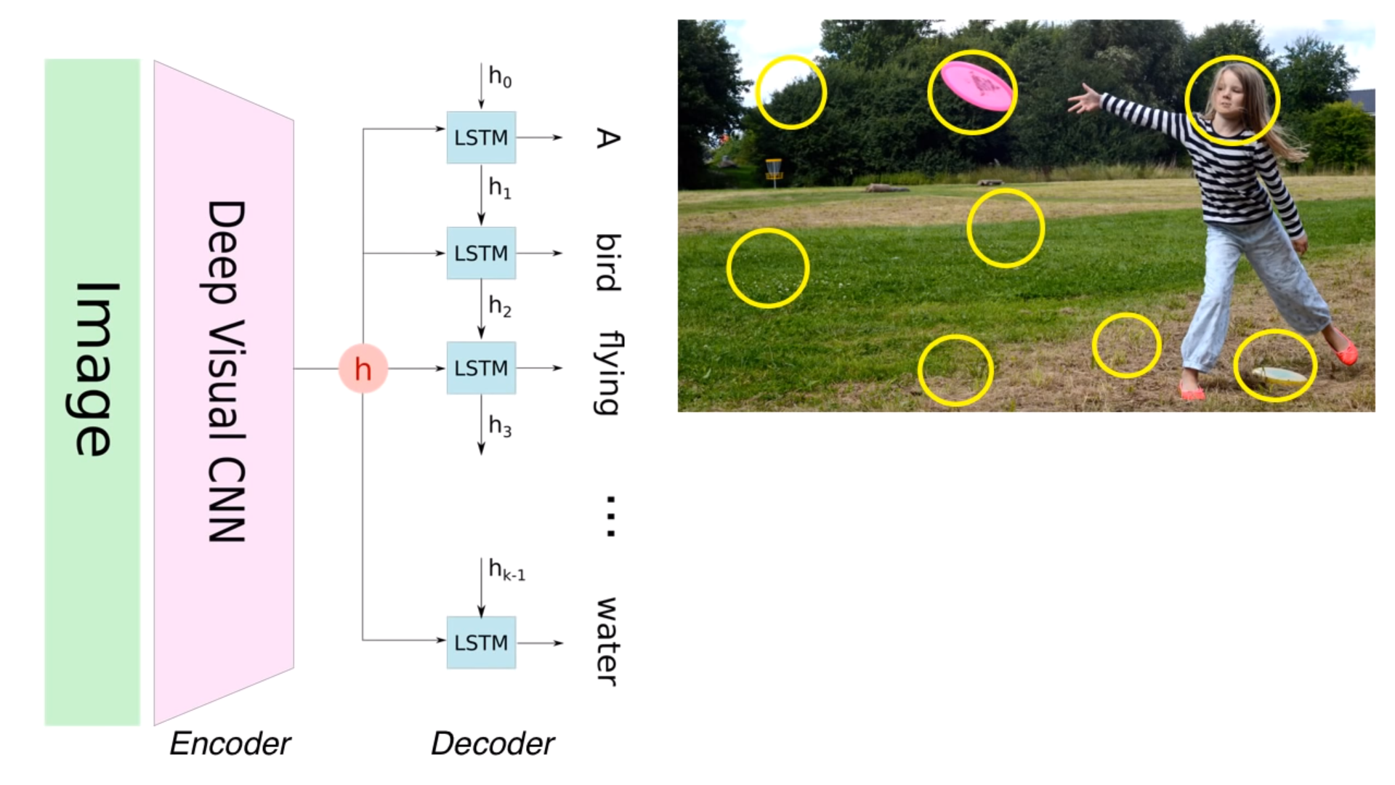

Slide 5
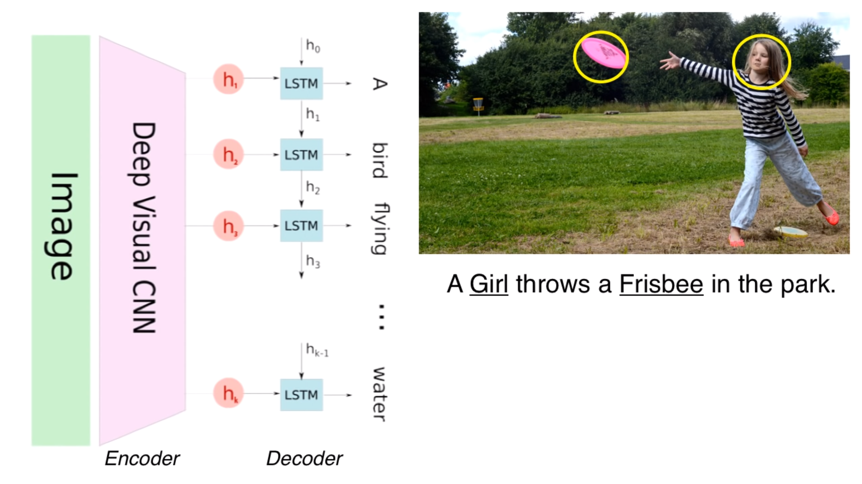

Slide 6
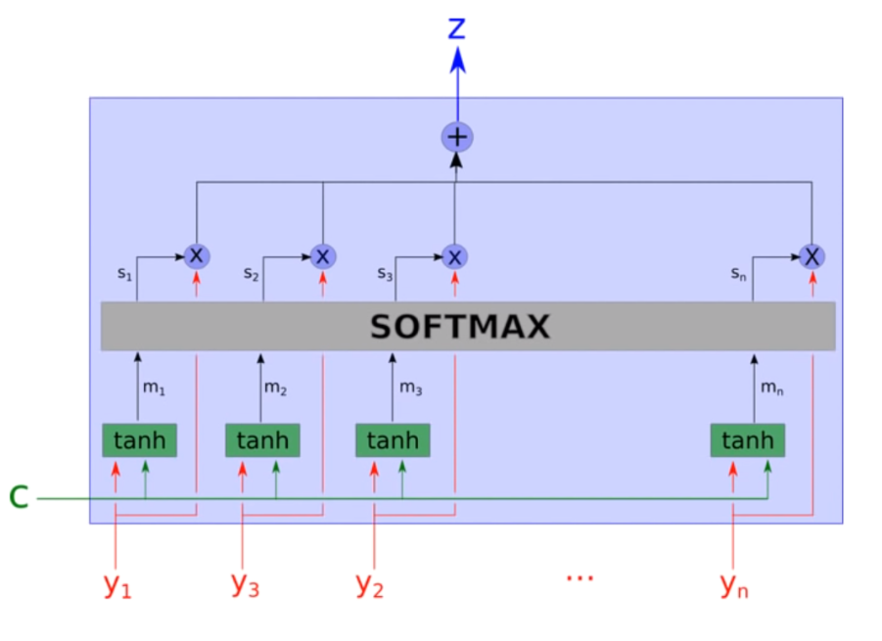
Attention Unit

Slide 7


Slide 8
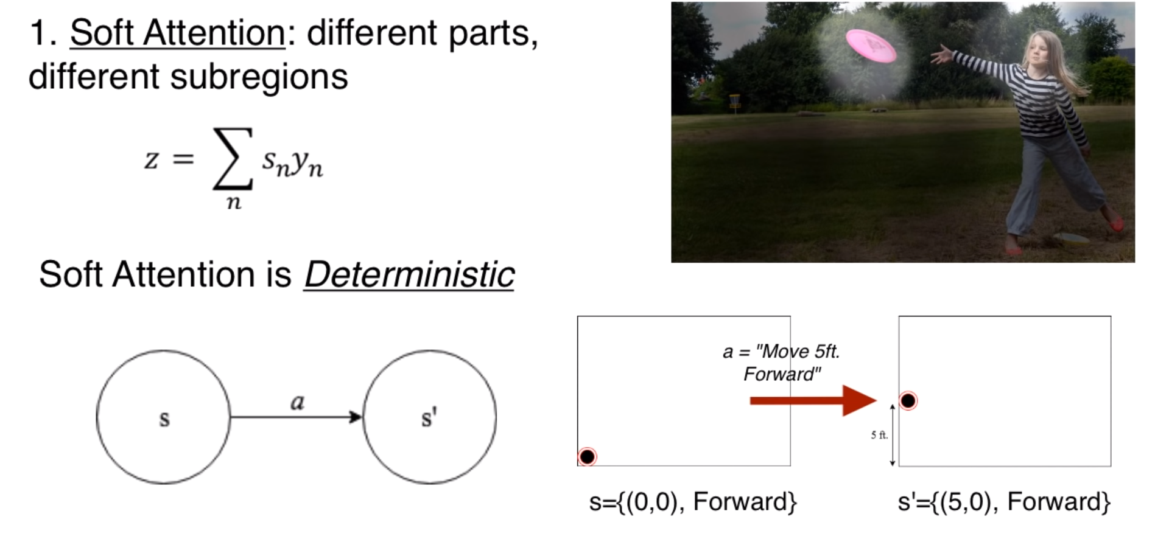
Types of Attentions

Slide 9
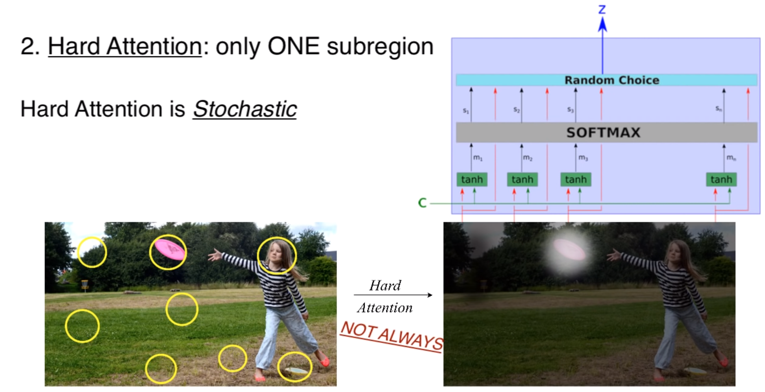

Slide 10
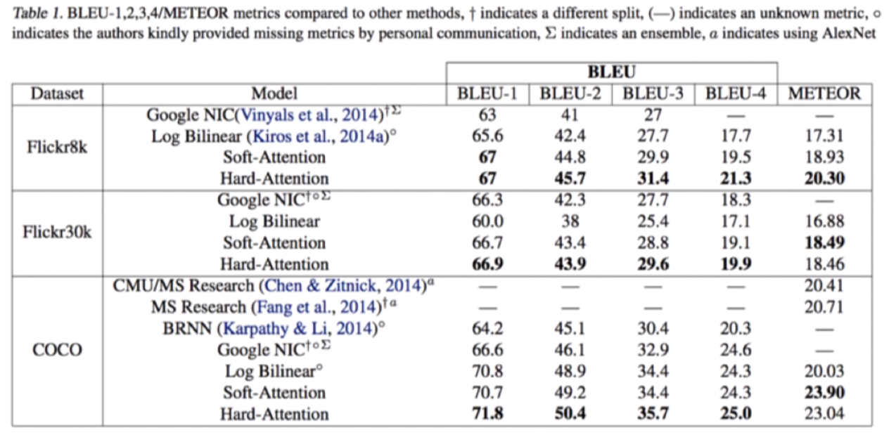
Performance

Slide 11
Summary
Attention involves focus on certain parts of input
Types of attention: Soft and Hard attention
Soft Attention is deterministic and hard attention is stochastic
Attention is used in NMT and image captioning and many other applications

